Slide 1
Teck Ghee Horizon A40

Slide 2
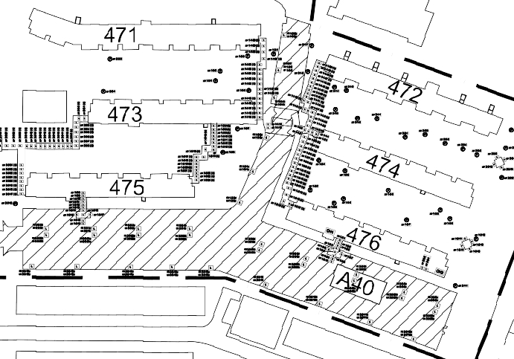
Block A40 CAR PARK SPACE PLAN

Slide 3
471
472
473
474
475
Ang Mo Kio Ave 10
A40
476

